Slide 1
DATA TYPES
Lecture 2

Slide 2
Primitive data types(Built-in/basic)
Primitive data types are data types that are typically directed upon by machine-level instructions, within the computer at their primitive level.
This include:
integer(int)
Reals (float, double)
Characters (char, string)
Boolean(logical); (bool, boolean)

Slide 3
Structured data types(SDTs)
A structured data type(SDTs) is a data type that is constructed by the user from the primitive(basic) data types.
This include:
Batches
Arrays
Records
Sets
SDTs are user defined types since it is the user to determine what structure the data is to have once the structure has been defined any variable can be defined to be of the user defined type.

Slide 4
Abstract data types(adts)
An abstract data type(ADTs) is a data type in which the axioms do not imply to a form of representation. i.e. we know what it does but we don’t know how it does what ever it does.
ADTs include:
Linked lists
Queues
Graphs
Trees
Stacks

Slide 5
Linear data structures and non-linear data structures
SDTs and ADTs may be classified as linear or non-linear data structures/types.
Linear structured data types(SDTs)
Batches
Records
Arrays
Linear Abstract data types(ADTs)
Linked list
Queues
Stacks
A linear data structure is a data structure(a list which refers to a linear collection of items) that display adjacency relationships in its elements.

Slide 6
Cont’ed
The most common organization for components is a
linear structure. A structure is linear if it has these 2 properties:
Property P1: Each element is `followed by' at most one other element.
Property P2: No two elements are `followed by' the same element.
We generally write a linearly structured data type like this: A->B->C->D (this is one value with 4 parts)
Example 1 (violates P1): A points to B and C B<-A->C
Example 2 (violates P2): A and B both point to C
A->C<-B

Slide 7
Non-linear data structures
A non-linear data structure is a data structure that does not show adjacency relationship between its elements.
Non-linear ADTs:
Labelled graphs
Trees

Slide 8
Linear data structure & their sequential storage representation
ARRAYS,LIST &FILES
An array is an ordered set which consist of a fixed number of objects.
An Arrays is a physically sequential, fixed size collection of homogeneous objects. In addition, objects with the structure have the random access property.
1. The array is physically sequential in that the data objects are stored in consecutive memory locations.
2. The array has a fixed size in that its size can neither be increased nor reduced though the number of items it contains can vary.

Slide 9
Cont’ed
3. The array is homogeneous in that they are made up of objects that are all the same type.
4. The random access property means that the time it takes to access one object in the structure does not depend on what object in the structure had been accessed previously.
Diagram
N/B: An array type is appropriate for representing an abstract data type when the following conditions are satisfied:
1) The data objects in the abstract data type are composed of homogeneous objects.
2) The solution requires the representation of a fixed, predetermined number of objects.

Slide 10
Referring to elements of the array
The position of an element in an array is given by the index. The name of the array, followed by the index, is used to refer to a particular element:
myArray[1] = 5;
The above statement assigns the value 5 to the element at the position 1(second element) of the array, myArray.
Using elements of an array
Elements of the array can be used in the same way as variables of the same data type can be used. i.e. an element of an array of integers can be used anywhere an integer variable can be used.

Slide 11
Advantages and disadvantages of an array
Advantages
Array data structure is simple to use(data storage and retrieval).
Elements in an array are stored in contiguous memory locations and hence each element can be accessed directly using their index.
Allocation and de-allocation of memory is done automatically by the computer.
Random access meaning that any location can be accessed in the same time as any other.

Slide 12
Disadvantages
1. The size of the array is fixed —
Most often this size is specified at compile time with a simple declaration such as in the example above. With a little extra effort, the size of the array can be deferred until the array is created at runtime, but after that it remains fixed.
2. Because of (1), the most convenient thing for programmers to do is to allocate arrays which seem "large enough" (e.g. the 100 items). Although convenient, this strategy has two disadvantages:
i. most of the time there are just 20 or 30 elements in the array and 70% the space in the array really is wasted.
ii. If the program ever needs process more than 100 scores, the code breaks.
3.Inserting new elements at the front or somewhere at the middle is potentially expensive because existing elements need to be shifted over to make room.

Slide 13
Linear list
A list is a sequence of zero or more elements of a given type (which we generally call the element type)
Such a list is usually represented as a comma separated sequence of elements i.e. a0, a1 , a2 ,…, an-1 where n≥0.
The number of elements n is said to be the length of the list.
Assuming n≥1, we say that a0 is the first element and an-1 is the last element.
If n=0, then we have an empty list i.e one with no elements
The position following the last position of the list can be termed as end(l),where l is the list and end(l)is a function that returns the position after the last. In C, it can be seen that end(l)=n.

Slide 14
Operations on linear lists
Access the element in position k.
Insert new element into list before or after a given k-th element -(Insertion)
Delete a specified k-th element ( Deletion)
Combine two or more lists into a single list ( Merging) (concatenation)
Divide the list into two or more lists
Sort the List according to the values of field in the elements(Sorting)
Search for an element in which a certain field has a given value (Searching)

Slide 15
Examples of List Operations
L1 = ( dog,cat,rat,bat)
InsertA(mouse,Locate(rat,L1),L1)
L1 = (dog,cat,rat,mouse,bat)
Delete(First(L1),L1)
L1 = (cat,rat,mouse,bat)
2. L2 = (apple,orange,pear,banana)
Concatenate(L1,L2)
L1 = (cat,rat,mouse,bat,apple,orange,pear,banana)

Slide 16
N/B
A file is typically the largest list that is stored in the memory of a computer.
A file is a collection of records.

Slide 17
Arrays
An array is a data structure consisting of items of the same data type.
Array is allocated a group of consecutive memory locations in which data of the same name and type is stored. The Figure below shows an array named scores.
Scores [5]
Each element in an array is access using array name eg Scores and subscript or index (Scores subscripts starts from 0 – 4).
An array can be a:
Single dimensional
Multi-dimensional
0 1 2 3 4

Slide 18
Single dimensional arrays
A single dimensional array is an ordered list. Assume we have score for 5 students whose marks are 89, 57, 70, 45 and 65
We can declare an array of 5 scores as:
int scores [5]
In general to declare a single dimensional array use the syntax:
type arrayname[num_of_elements]
To initialize the array with the five elements use:
int scores [5]={89, 57, 70, 45, 65}

Slide 19
example
#include <stdio.h>
int main()
{
//assign and initialize scores array with 5 scores
int x, scores[5]={30, 70, 89,34,70};
//display memory location of each element in the array
for (x=0;x<5;x++)
{
printf("Score[%d] address is = %d\n",x,&scores[x]);
}
//Display the five scores
for (x=0;x<5;x++)
{
printf("The score[%d] is = %d\n", x,scores[x]);
}
return 0;
}

Slide 20
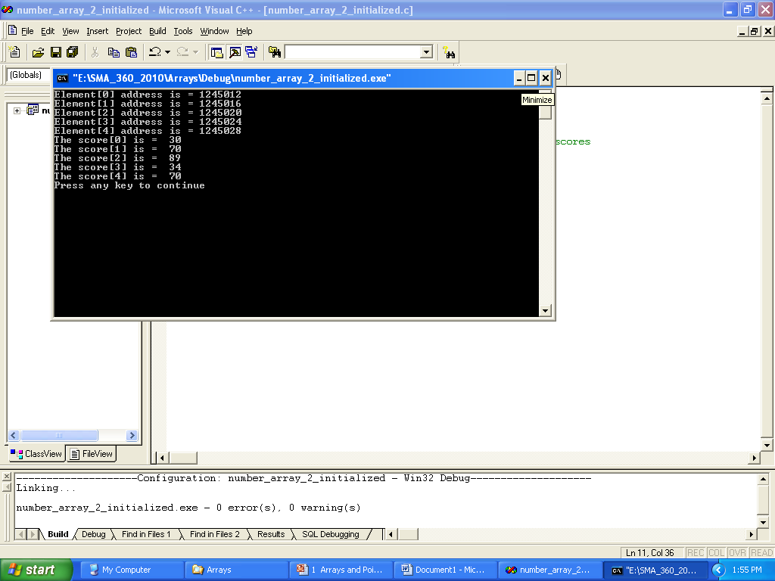
output

Slide 21
Array of characters
To manipulate text, we create an array of characters:
char arrayname [elements] e.g. char Student_Name [20];
Character arrays can be initialized using string literals. For example
char City[20] = “Nairobi";
City actually has 7 elements but the extra 8th space is used to store the Null character '\0' that terminates the string.
Since Array name is address of an array, & is not needed for scanf (): scanf( "%s", name );.

Slide 22
example
#include<stdio.h>
int main ()
{
char name[20];
char course [40]= "Data Structures & Algorithms";
printf("Enter name");
scanf("%s",name);
printf("Your name is %s \n",name);
printf("Taking a %s Bridging course\n",course);
return 0;
}

Slide 23
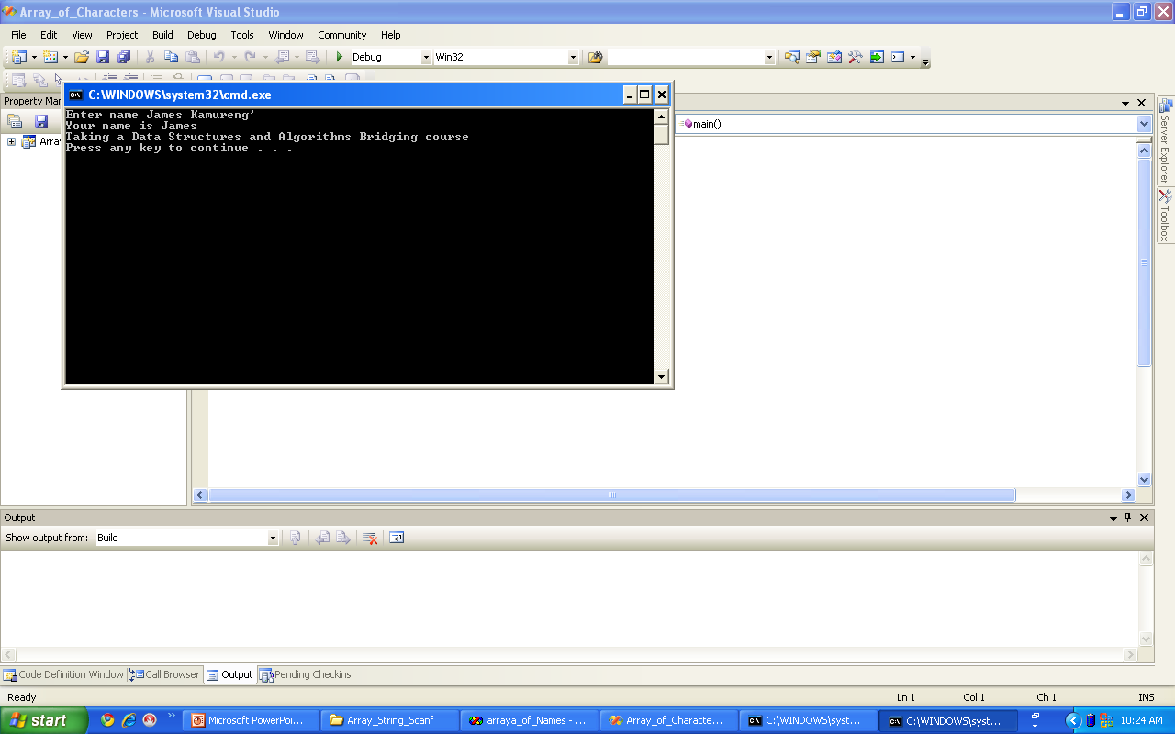
Array of Char output

Slide 24
C++
int i,score[100];
for(i=0;i<100;i++)
{
cout<<“enter the score for students:”
<<i+1;
cin>>score[i];
cout<<endl; //or cout<<“/n”;
}
for(i=0;i<100;i++)
{
cout<<“the score for student”
<<i+1<<“is:”;
<<score[i]<<endl;
}

Slide 25
Multi Dimensional Arrays
These are the arrays which has more than one dimension. For example, the following declaration in C creates a two-dimensional array of two rows and two columns:
int myArray1[4,2]
The following declaration creates an array of three dimensions, 2, 2, and 3:
int myArray2[4,2,3];
Initialization
The following piece of code initializes the arrays myArray1 and myArray2
myArray1 = {(1, 2), (3, 4)}
myArray2 = {(1, 2), (3, 4), (5, 6)}
In a matrix form the above array can be represented as below

Slide 26
example
#include <stdio.h>
const int num_rows = 7;
const int num_columns = 5;
int
main()
{
int box[3][4];
int row, column;
for(row = 0; row < num_rows; row++)
for(column = 0; column < num_columns; column++)
box[row][column] = column + (row * num_columns);
for(row = 0; row < num_rows; row++)
{
for(column = 0; column < num_columns; column++)
{
printf("%4d", box[row][column]);
}
printf("\n");
}
return 0;
}

Slide 27
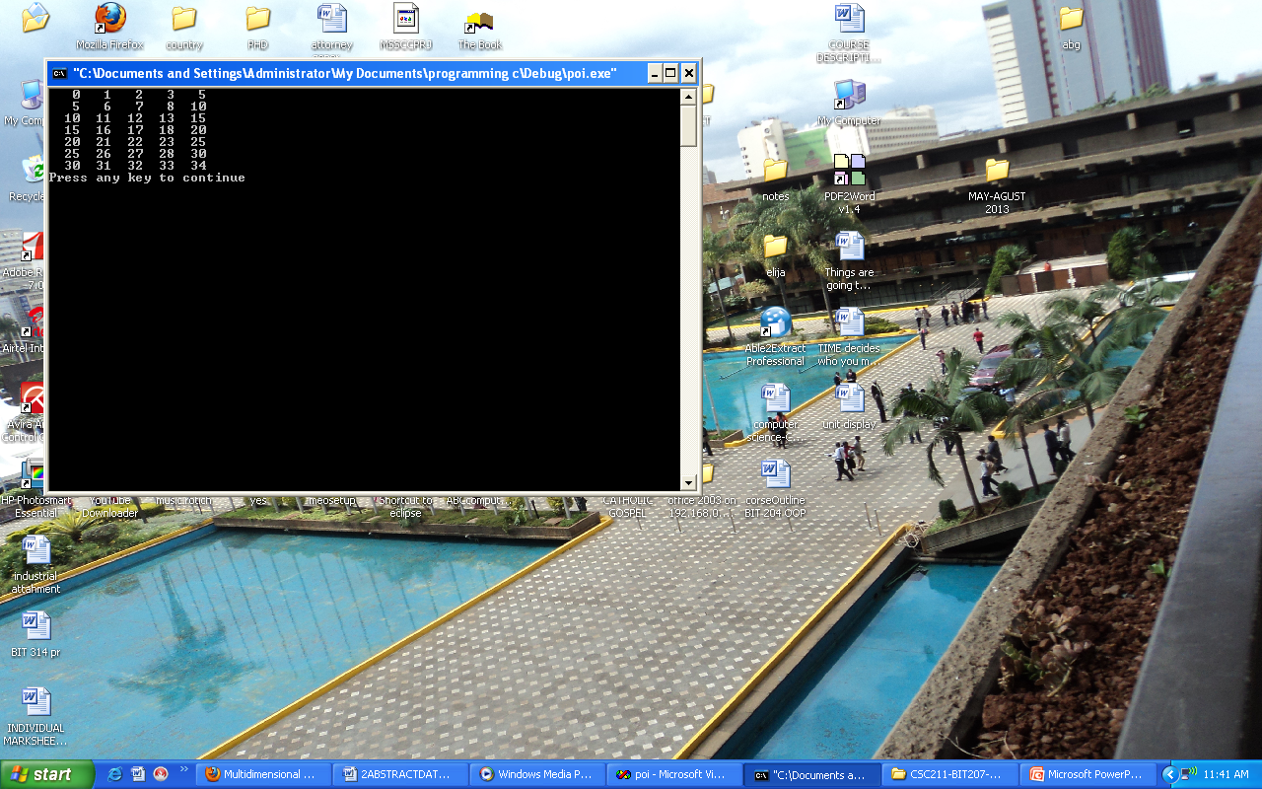
output

Slide 28
Memory Organization in an array
Array elements occupy contiguous locations in memory. The array elements are accessed using their index. A function is needed to translate an array index to the address of the indexed element. For a single dimensional array the address can be calculated as below:
Address = Base Address + (Index – Base Index) * Size
Where,
- Base Index represents the value of the first index in the array
-size represents the size of a single element in bytes

Slide 29
Array operations
Other that creating and displaying array elements, other operations that can be performed on an array are:
Search for an element in the array
Insert and delete an elements
Reverse and sort elements in the list

Slide 30
List insertion
The insertion operation requires that we insert a new element x at position i of the list.
To achieve this ai through an-1 are shifted one position up the list so that element ai moves to position of ai +1 and an-1 to position of an.
A total of ( n- i) )) elements are shifted.
An algorithm for the procedure can be represented in a flow chart .

Slide 31
diagram
Insertion into a Linear List (Insert Element x into position i)

Slide 32
Algorithm of inserting into linear list using array
Diagram
Explanation
1.First step if i > n then error is flagged; since we only have n elements, a new element can only be inserted at position n or less.
2. Next an initial value is assigned to j i.e. j = n-1.
3. Then compare j and i. If j > = i then move aj( i.e. V [ j] ) to position j+1 ( i.e. V[j+1).
i. The first to be moved is V[n-1]. Then change index i.e. j changes to j-1, compare j and i and the shifting continues until j = i
ii.Then V[i] = V[i+1], that is i moved to (i+1)th position.
iii. Next comparison will stop since j = i-1 hence less than i
At this point ith position is vacant for which next operation is performed V[i] = x that is x is inserted in position i and length of list is increased to n+1 from n.
iv. End of Insertion steps

Slide 33
Insertion into a List-C Program
#include <stdio.h>
#define MAX 10
int V[MAX] = {1,23,17,4,-5,100};
int n=6, j;
// Inserting function
void list_insert(int
listname[],int x,int i)
{
if(i>n || n>MAX-2)
{
printf("\Overflow error \n");
return;
}
else if(i<0)
{
printf("\ninvalid position\n");
return;
}
j=n-1;
while(j>=i)
{ listname[j+1]=listname[j];
j=j-1;
}
listname[i] = x;
n=n + 1;

Slide 34
Cont’ed
int main(void)
{int i=0,x=0,j=0;
printf("Enter your position <%d\n“,MAX-1);
scanf("%d",&i);
printf("Enter your element \n");
scanf("%d",&x);
printf("Position is %d\n",i);
printf("Element is %d\n",x);
printf("\n\n");
printf("******** Before Insertion
********** \n");
printf("\n\n");
for (j = 0; j < n; j++)
{
printf("V[%d] = %d",j,V[j]);
}
// Call insert element function
list_insert(V,x,i);
printf("\n\n");
printf("*********** After Insertion
************* \n");
printf("\n\n");
for (j = 0; j < n; j++)
{
printf("V[%d] = %d",j,V[j]);
}
return 0;
}

Slide 35
C++
#include <iostream.h>
#define SIZE 8
int LIST[SIZE] = {21,22,23};
int n=2, j;
// Inserting function
void insert_list(int x,int i)
{
if(i>n || n>SIZE-1)
{
cout <<"\n Overflow error \n";
return;
}
else if(i<0)
{
cout << "\n invalid position\n";
return;
}
j=n-1;//initilizes j a temporaly variable for shifting
while(j>=i)
{
LIST[j+1]=LIST[j];//shifting code
j=j-1;
}
LIST[i] = x;//insertion code
n=n + 1;

Slide 36
Cont’ed
}
int main(void)
{ int i=0,x=0,j=0;
cout << "Enter your position" <<endl;
cin >> i;
cout << "Enter your element \n";
cin >> x;
cout << "Position is "<< i;
cout << "\nElement is "<< x;
cout << "\n\n";
cout << "*********** Before Insertion ************ \n";
cout << "\n\n";
for (j=0;j<n;j++)
{
cout << j << "\t" << LIST[j]<<"\n";
}
// Call insert element function
insert_list(x,i);
cout << "\n\n";
cout << "*********** After Insertion ************* \n";
cout << "\n\n";
for (j = 0; j < n; j++)
{
cout << j << "\t" << LIST[j]<<"\n";
}
return 0;
}

Slide 37
Lists- Insertion:C program Expected output
Output
Delete an element from a list
involves deleting an element ai (at position i) from a list (a0 a1…an-1).
After deleting the ith element, elements in (i+1) position to position n-1 are shifted one position backwards and length of list adjusted to n-1.
Total of (n-i-1)) elements are moved backwards.

Slide 38
Delete an element from a list
Diagrams
Algorithm Steps.
i and n are compared
if i >= n then error is flagged (the last element is at position n-1)
Else assign i to j (initial value of index j).
Next compare j and n-1 till j >= n-1 , end if j is greater or
equal to n – 1 (we have shifted all elements)
Else shift V[j+1] to V[j] then increment j to j +1 and loop

Slide 39
Lists- Deletion: C program
#include <stdio.h>
#define MAX 10
int V[MAX] = {1,23,17,4,-5,100};
int n=6, j;
// Deleting function
void list_delete(int listname[],int i)
{
int j;
if (i>=n)
{
printf(“\nError in deleting \n");
return;
}
j=i;
while(j<=n-1)
{
listname[j]=listname[j+1];
j=j+1;
}
n=n-1;
}

Slide 40
Cont’ed
int main(void)
{
int i=0,j;
printf("Enter your position \n");
scanf("%d",&i);
printf("Position is %d\n",i);
printf("\n\n");
printf("***** Before deleting ******* \n");
printf("\n\n");
for (j = 0; j < n; j++)
{printf("V[%d] = %d ",j,V[j]);
}
// Call delete element function
list_delete(V,i);
printf("\n\n");
printf("*********** After deleting ************* \n");
printf("\n\n");
for (j = 0; j < n; j++)
{
printf("V[%d] = %d ",j,V[j]);
}
return 0;
}

Slide 41
Lists- Deletion:C program expected output

Slide 42
C++
#include <iostream.h>
#define MAX 10
int LIST[MAX] = {25,21,20,22,123};
int n=5, j;
// Deleting function
void list_delete (int i)
{
int j;
if (i>=n)
{
cout<<"\nError in deleting \n";
return;
}
j=i;
while(j<=n-1)
{
LIST[j]=LIST[j+1];
j=j+1;
}
n=n-1;
}

Slide 43
Cont’ed
int main(void)
{
int i=0,j;
cout<<"Enter your position \n";
cin>>i;
cout<<"Position is \n"<<i;
cout<<"\n\n";
cout<<"********** Before deleting ************* \n";
cout<<"\n\n";
for (j = 0; j < n; j++)

